Slide 1
Appendix B:
Managing the Alice interface

Slide 2
Outline
Searching the gallery
Copy and paste: clipboards
Deleting code
Printing: Exporting program code to an HTML file
Web display: Exporting a world
Export a video
Uploading a video to the Internet
Troubleshooting Sound Files

Slide 3
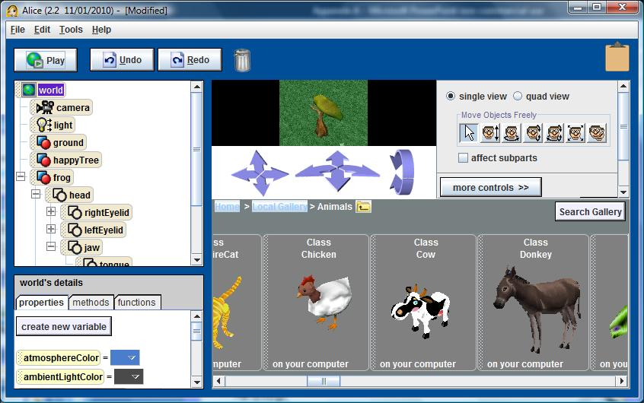
Searching the gallery
You can search the gallery for a particular kind of object

Slide 4
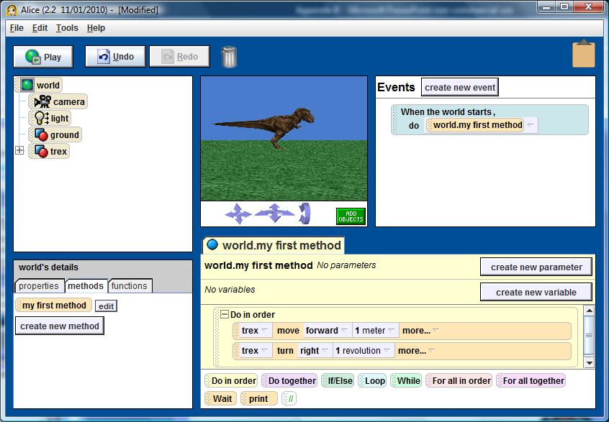
Copy to clipboards

Slide 5
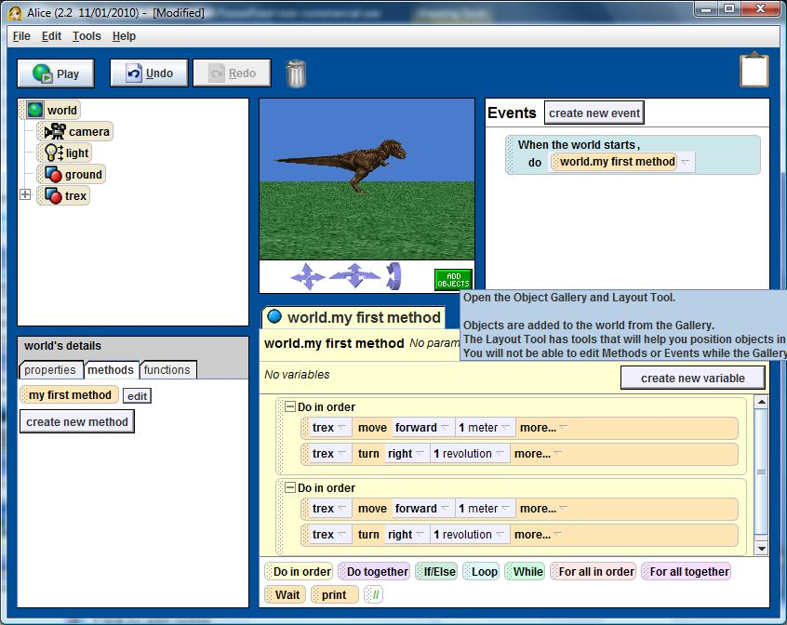
Paste from Clipboard

Slide 6
Deleting code

Slide 7
Printing: Exporting program code to an HTML file
File
  Export Code For Printing…
In the dialog box
  Select the name of the method (or methods) to be printed
  Browse for the folder where the document is to be stored
  Type your name

Slide 8
Web display: Exporting a world
File
  Export As a Web Page…
In the dialog box
  Type the title
  Type the author’s name
  Type the Size in the Browser
  Specify the Save Location (not a URL)

Slide 9
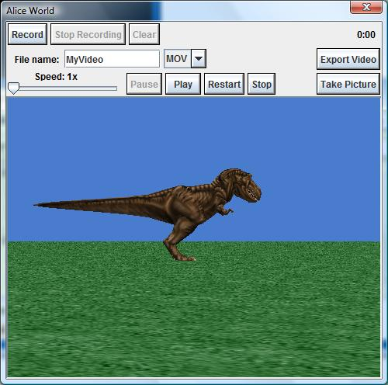
Export a video
File
  Export Video…
The video is in QuickTime format

Slide 10
Uploading a video to the Internet
You can upload a video to a video online site
YouTube (Broadcast Yourself)
  Go to YouTube Home Page
  Click Upload button (or link)
  Login or create an account
  Complete the form for uploading
  The file is converted to a Flash format

Slide 11
Troubleshooting Sound Files
If opening a saved world causes a “media.PlaybackEngine” error, one of your sound files is not being loaded
  Check the list of imported sounds in the detail panel to identify the sound file
  Open the original sound file in a different sound editor than the one used to create it
  Export the sound as a WAV file to reformat
  Import the new formatted file into Alice

